Slide 1
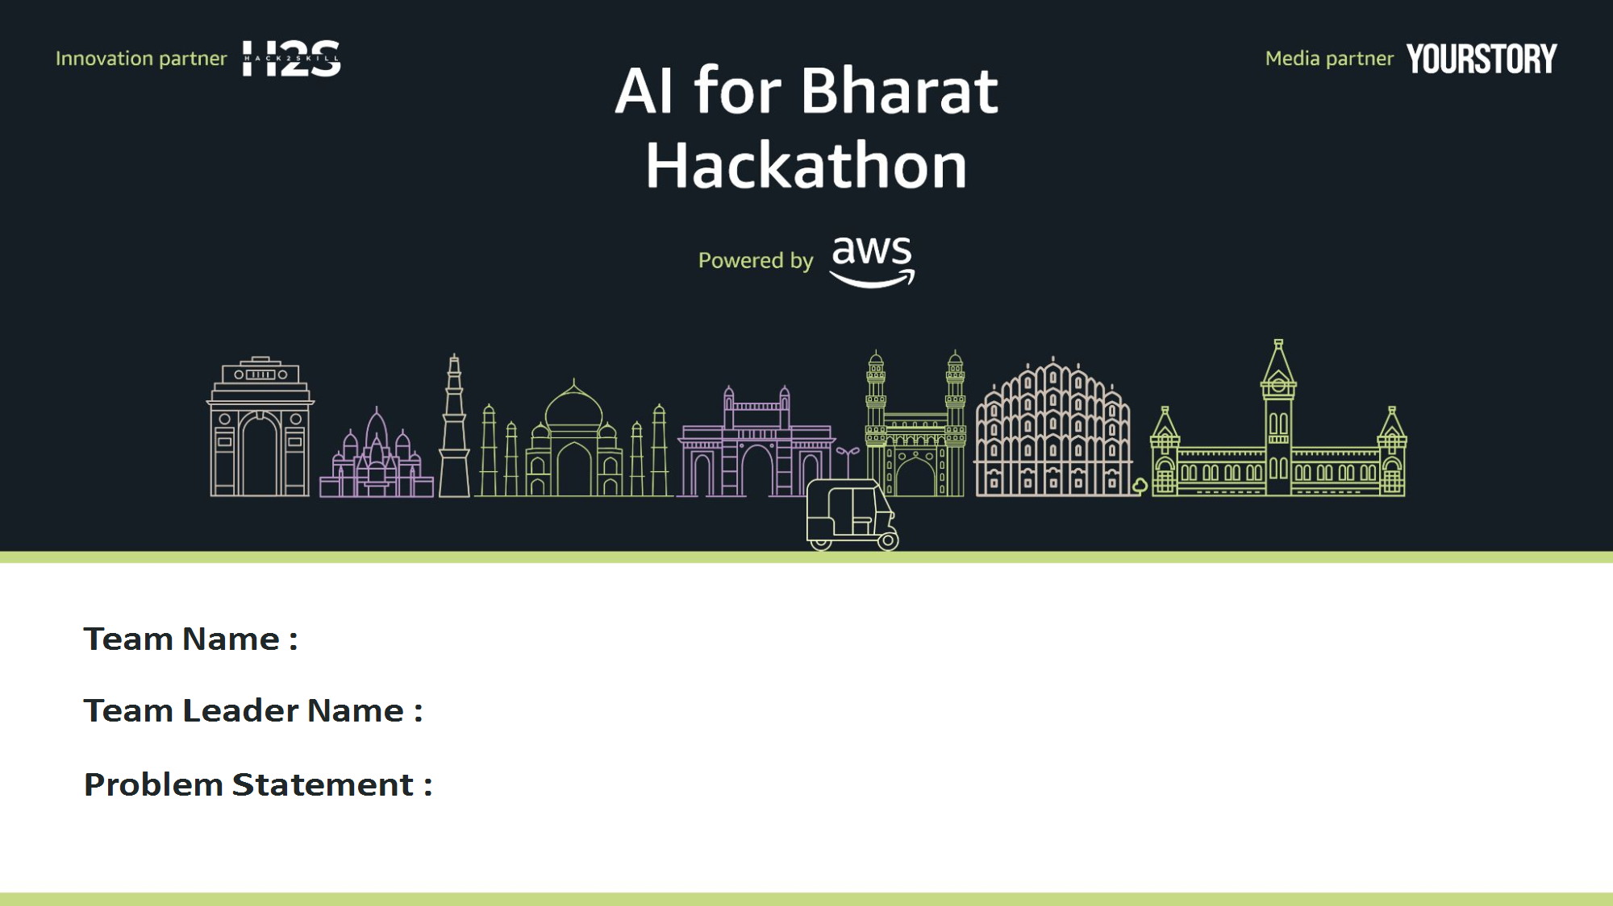
Hack4Impact
Gowrish N
AI for Learning & Developer Productivity

Slide 2
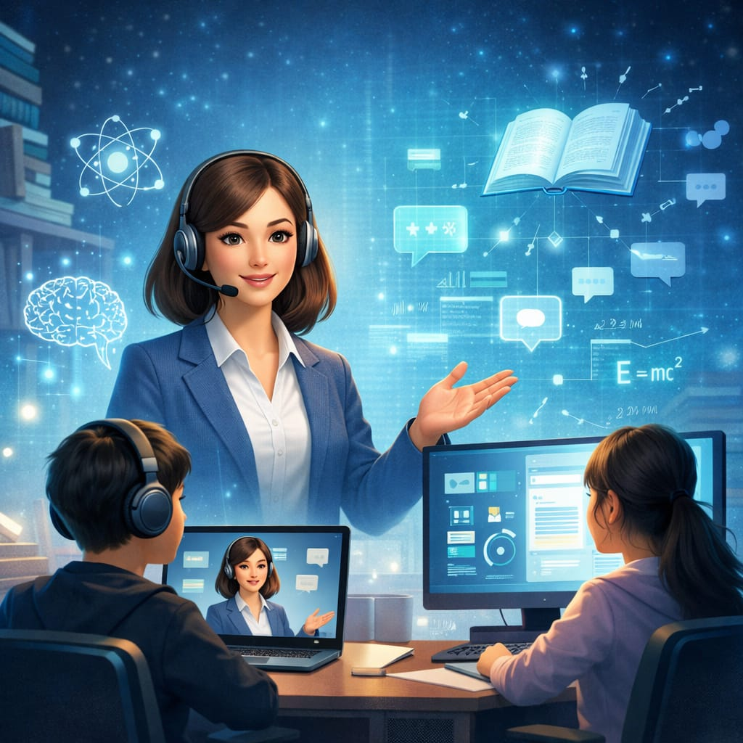
Brief about the Idea:
Bolt AI Tutor (Saarathi) is an AI-powered interactive learning platform that provides a real-time AI mentor capable of teaching concepts through voice, text, and video explanations.
Unlike traditional platforms that provide static video lectures, Saarathi generates dynamic lessons based on the learner’s skill level.
Key idea:
Personalized AI tutor
Real-time explanations
Voice and text interaction
Adaptive learning for students and developers
The platform converts passive learning into an interactive AI-driven experience.

Slide 3
How AWS is Used
AWS cloud powers the system:
Amazon Bedrock → AI lesson generation
Amazon Transcribe → Speech-to-text input
Amazon Polly → AI voice output
Amazon S3 → Content storage
Amazon DynamoDB → Learning data storage
AWS Lambda → Serverless processing
CloudFront → Fast content delivery
Value of AI Layer
AI transforms learning by providing:
Instant explanations
Adaptive difficulty levels
Interactive two-way teaching
Personalized feedback
Why AI is Required
AI enables:
Personalized learning paths
Real-time explanation generation
Intelligent doubt solving
Adaptive teaching based on user performance

Slide 4

List these features:
Core Features
1️⃣ Smart onboarding & skill detection 2️⃣ Real-time AI video tutor 3️⃣ Adaptive learning engine 4️⃣ Voice + text doubt solving 5️⃣ AI-generated quizzes & practice questions 6️⃣ Progress tracking & analytics dashboard 7️⃣ Multi-language support for Indian users 8️⃣ Developer productivity tools (code explanation)

Slide 5
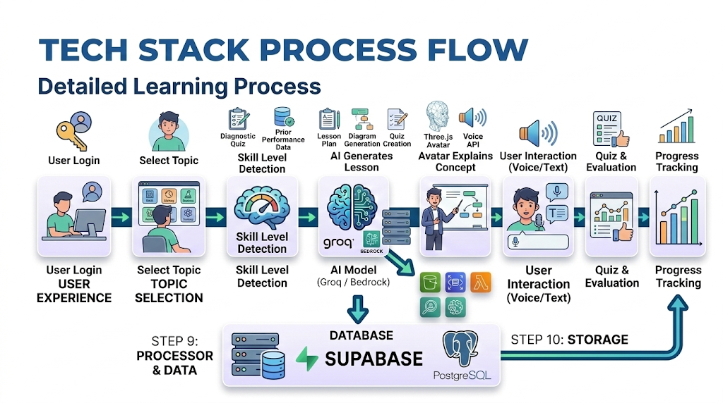

Slide 6
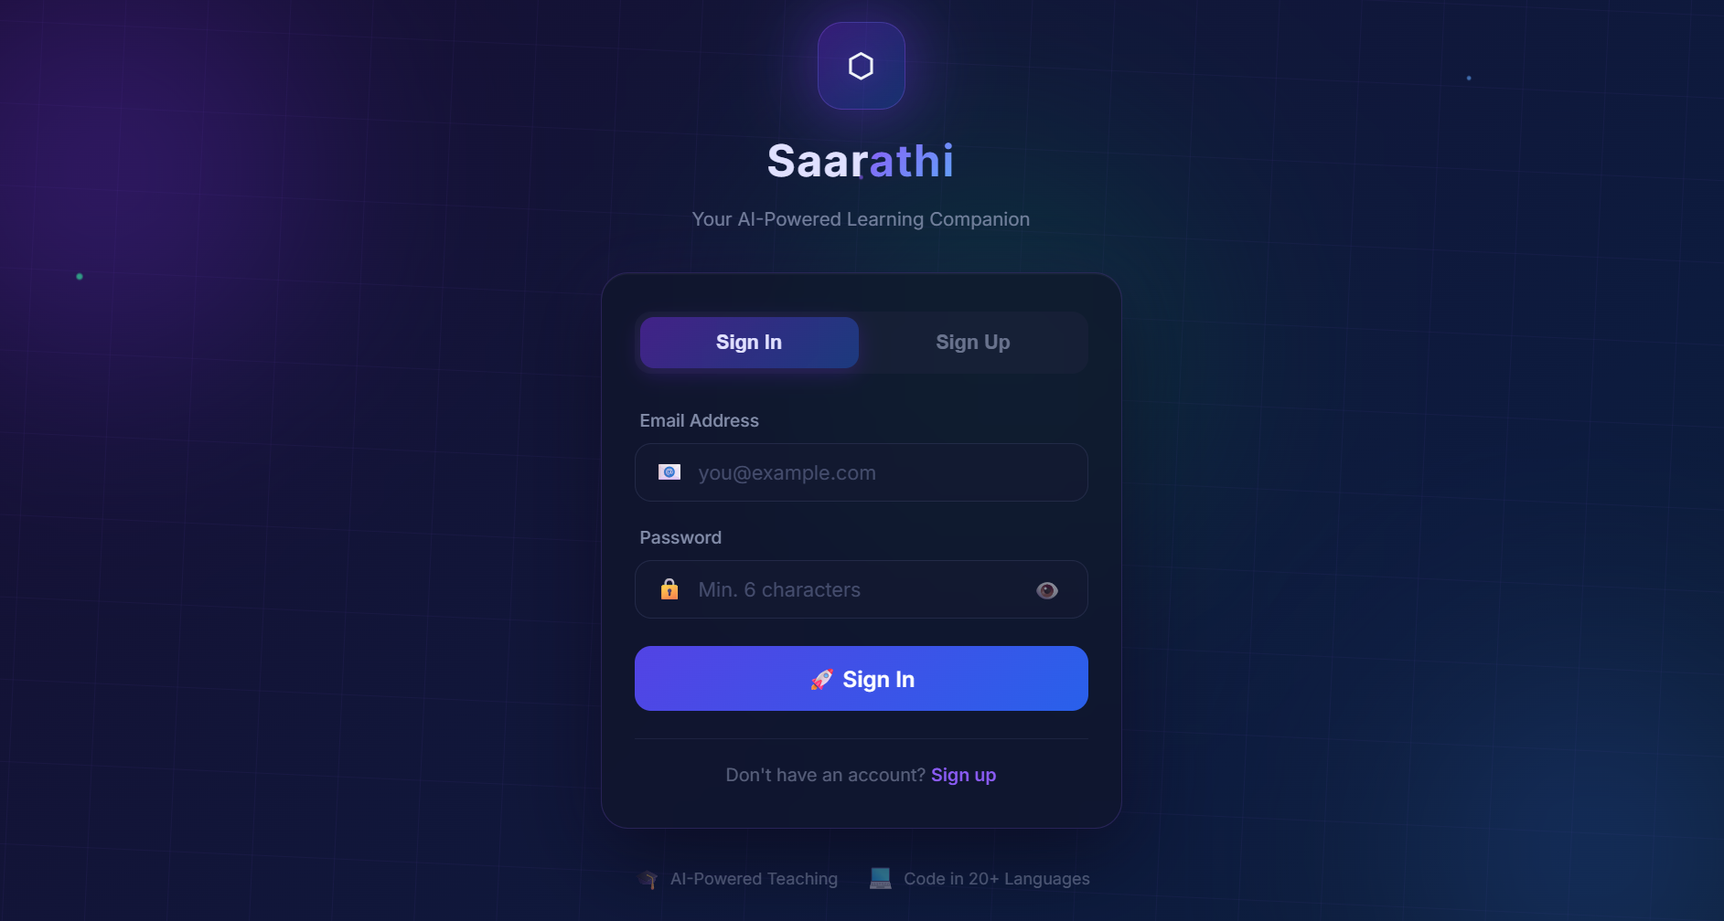
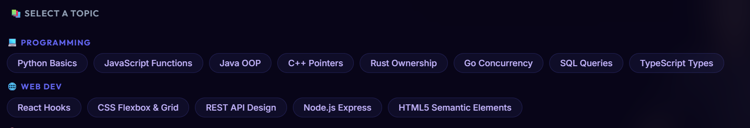
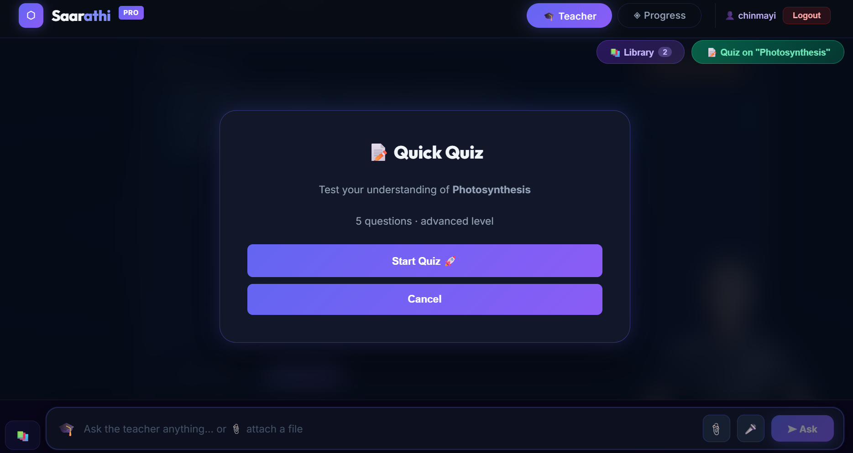
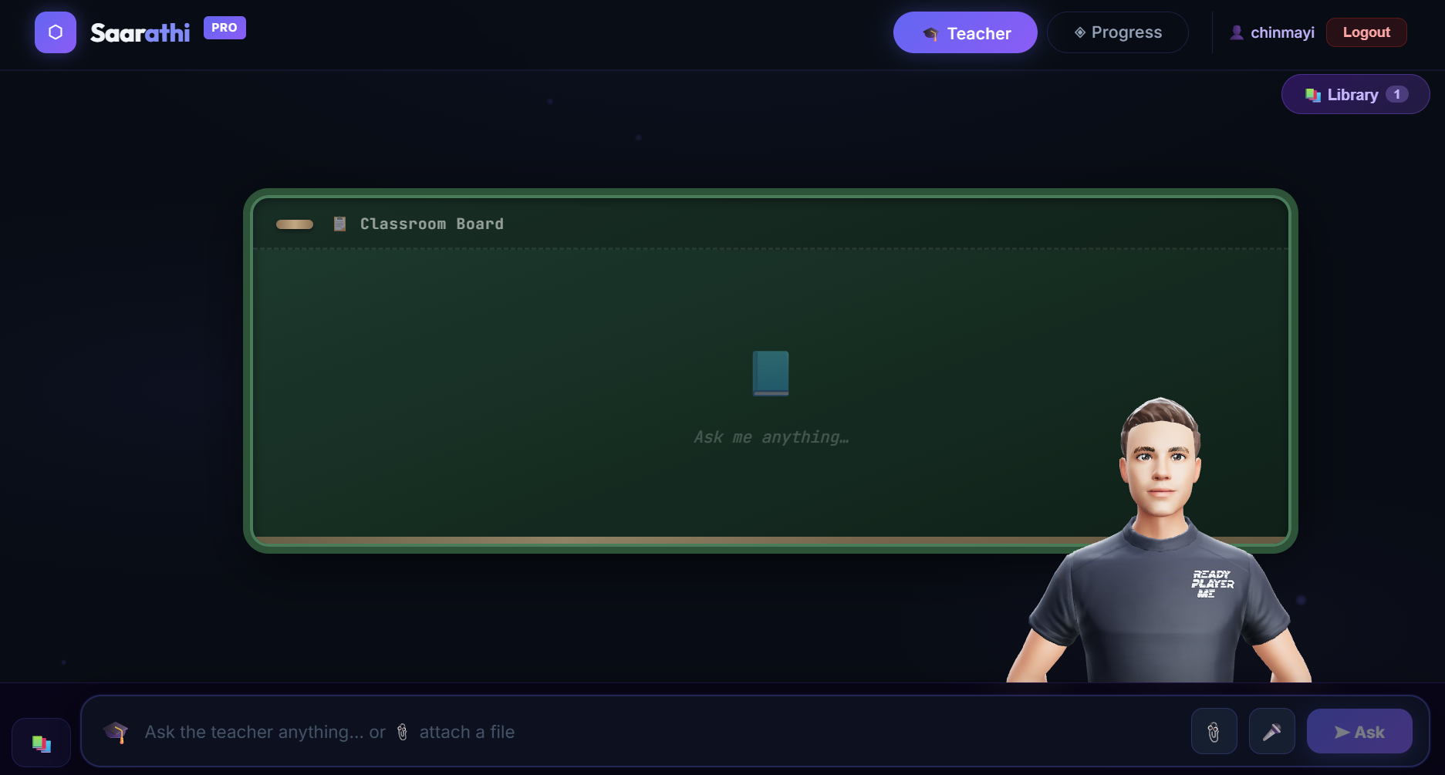

Slide 7
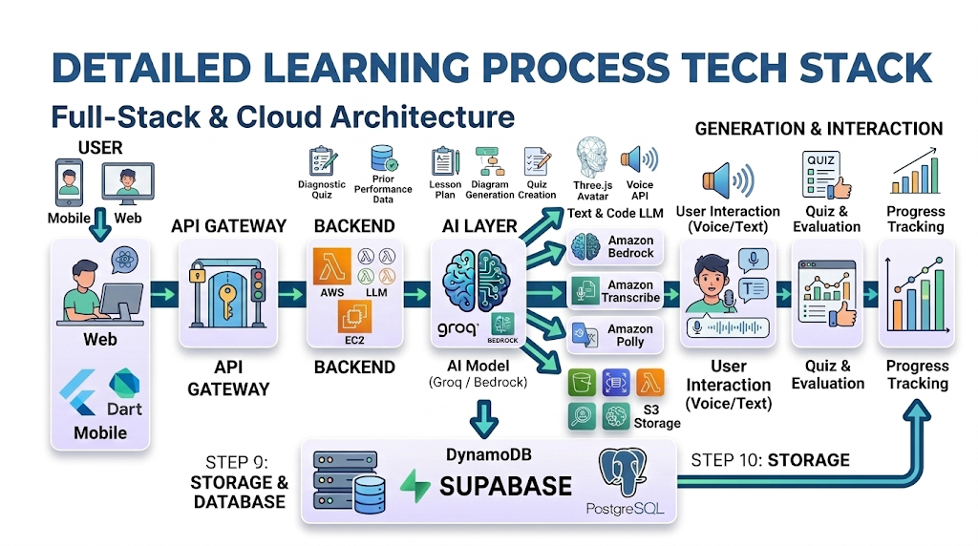

Slide 8
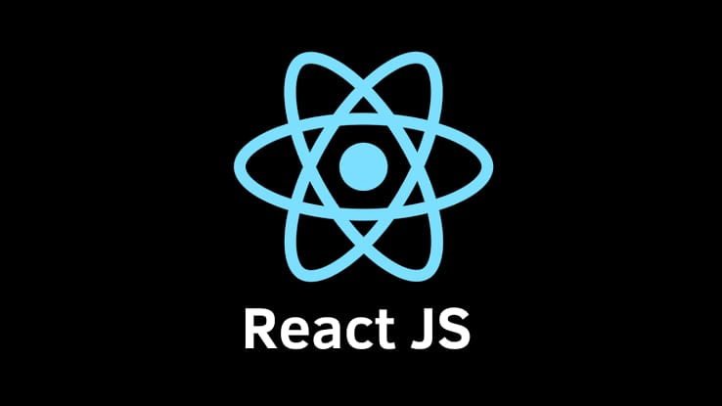

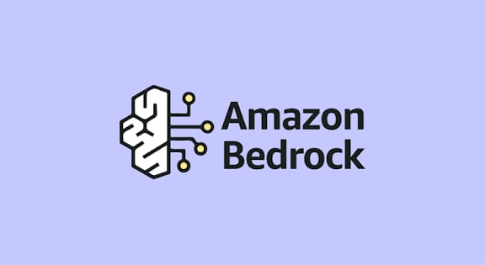
AI & ML
Amazon Bedrock
AI Avatar Engine
Personalization Engine
Technologies:
Frontend
React.js
Flutter
HTML / CSS / JavaScript
Cloud (AWS)
AWS EC2
AWS Lambda
API Gateway
Amazon S3
DynamoDB
CloudFront
Backend
FastAPI / Python
REST APIs

Slide 9
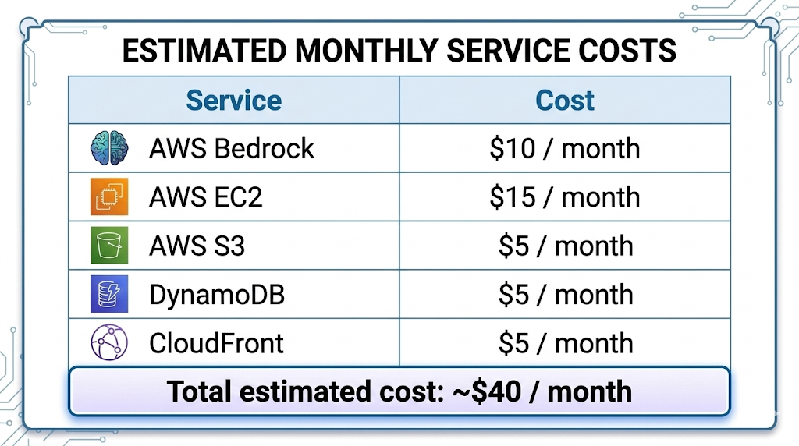

Slide 11
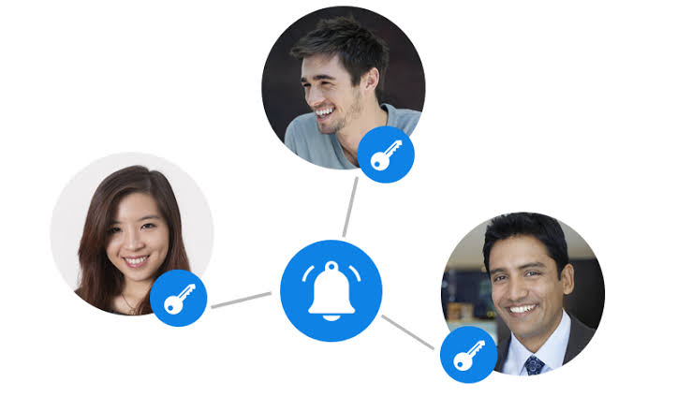
Prototype Performance:
Average AI response time: 2–4 seconds
Voice processing latency: <2 seconds
System scalability via AWS cloud
Supports multi-user learning sessions

Slide 12


Future improvements:
3D AI avatar tutor
Real-time classroom simulation
Offline learning mode
More Indian language support
AR/VR based immersive learning

Slide 13
